Slide 1
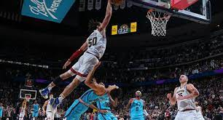
Denver Nuggets Efficiency/Performance
Danielle Contreras

Slide 2
Goal of Project
My main goal was to analyze NBA data in R and specifically the Denver Nuggets
I wanted to explore some different things with the data, I went in not knowing exactly what I was going to do or which variables I was going to use

Slide 3
What this project covers
NBA CourtOptix
Most ideal shots for players
Different Advanced Statistics
Cohens D for each player (different advanced statistics)
Cohens D for team (different advanced statistics)

Slide 4
Data Resources
BasketballAnalyzeR
Hoopr
ballr
NBA CourtOptix
Basketball Reference

Slide 5
NBA CourtOptix
“NBA CourtOptix tracks and analyzes action on the court and generates insights behind every shot, pass and play.”- NBA Courtoptix
Can look at tracking data
Looks at ball screens, passing network, passing, double teams, defensive scores, and shooting.
I will look at ball screens and passing networks.
All other metrics are not interactive, they just give out basic stats and top in each metric

Slide 6
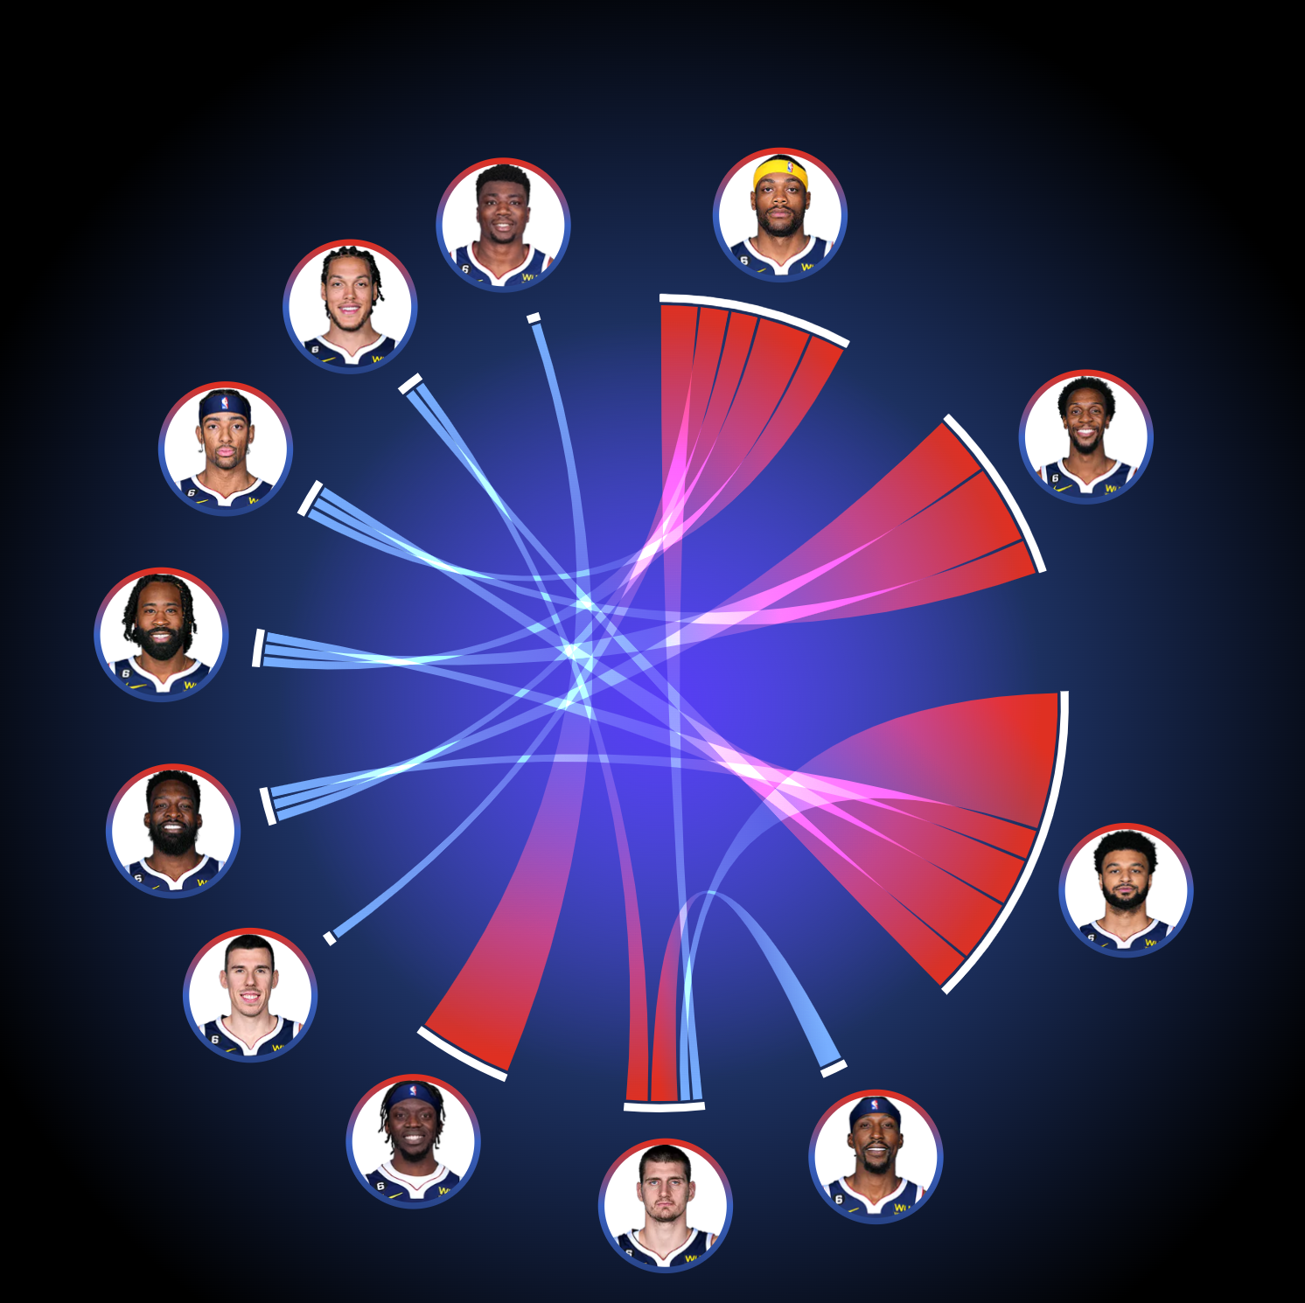
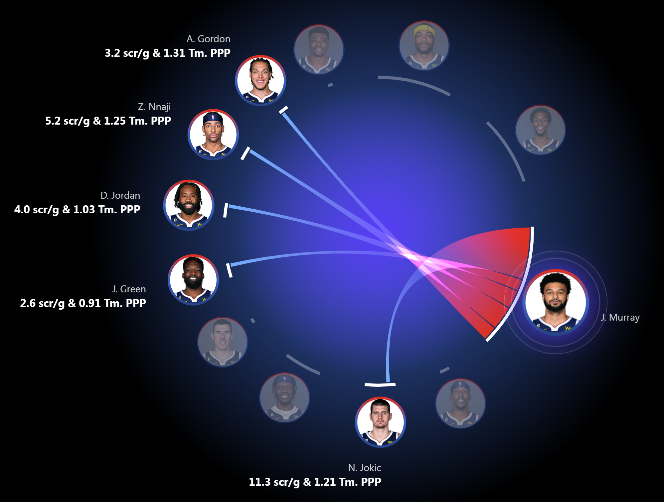
Screens

Slide 7
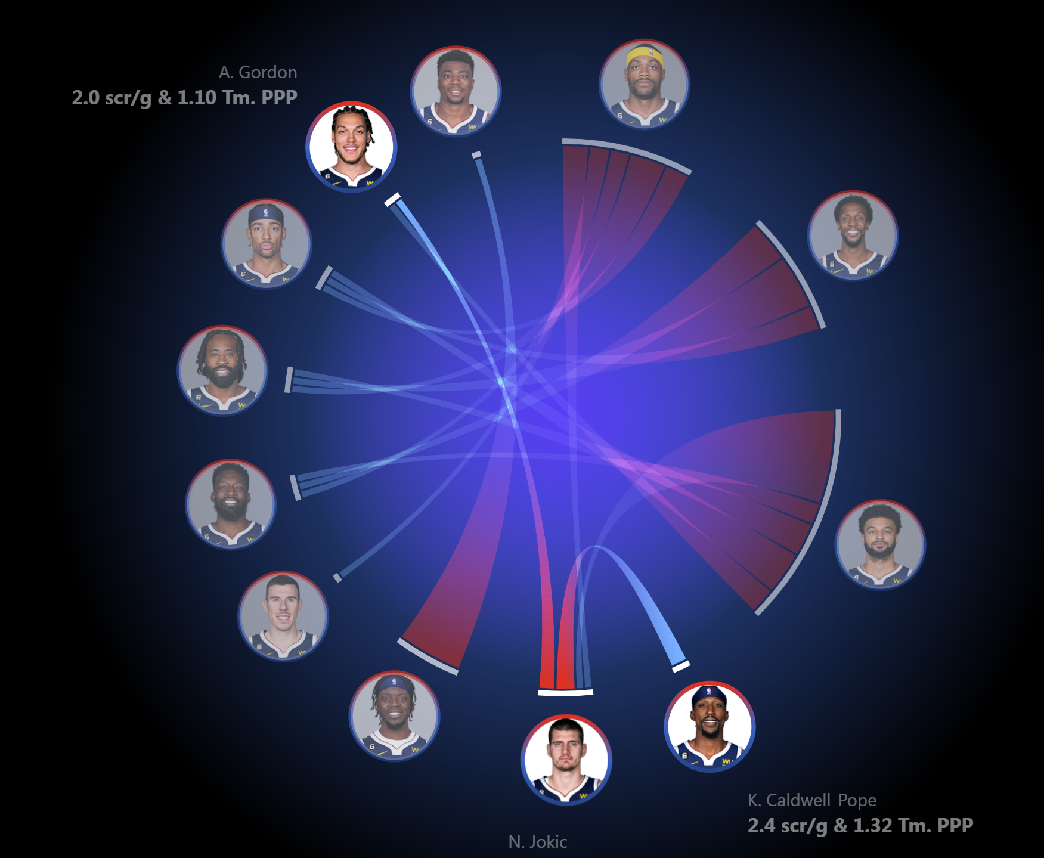
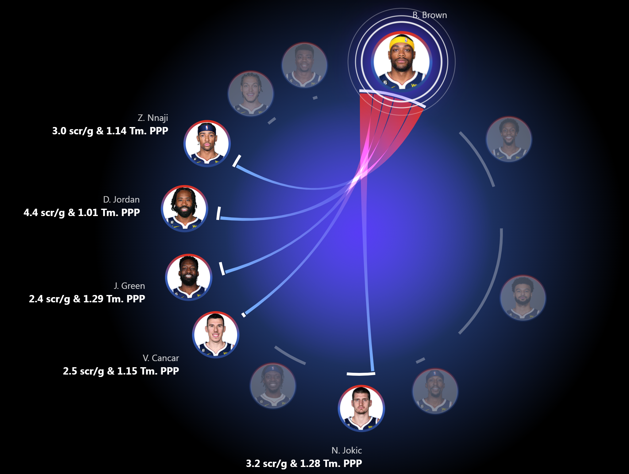

Slide 8
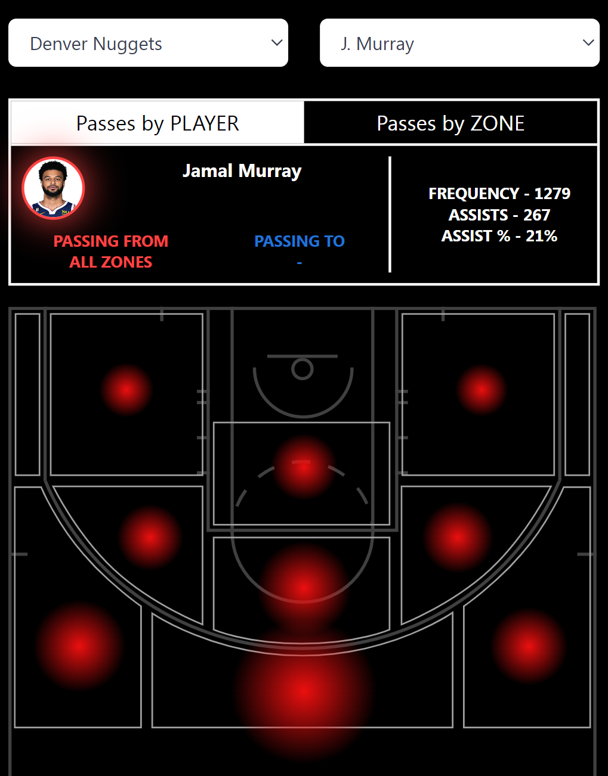
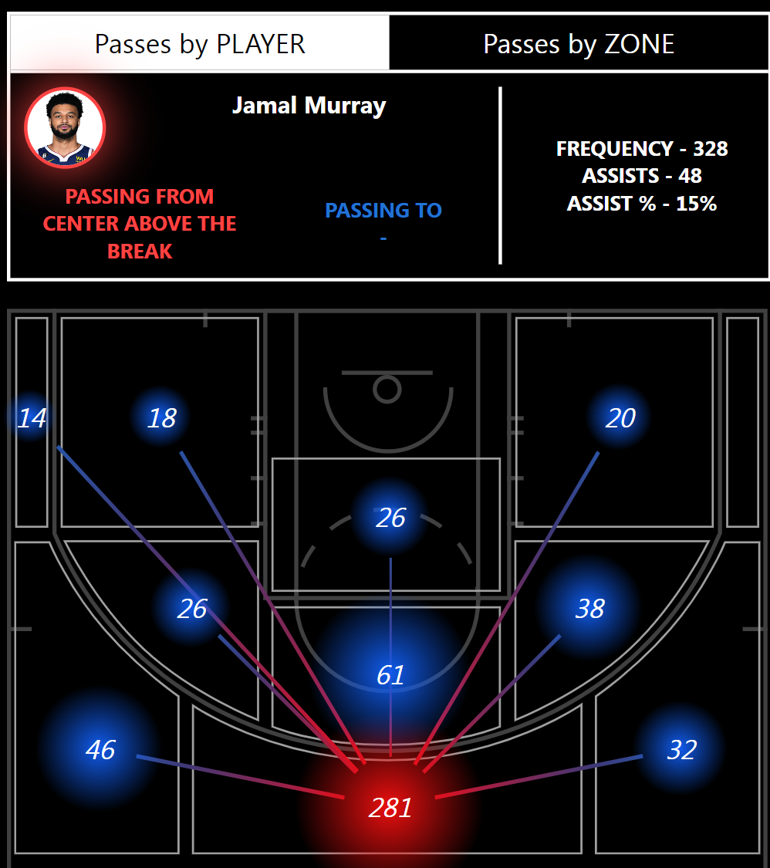
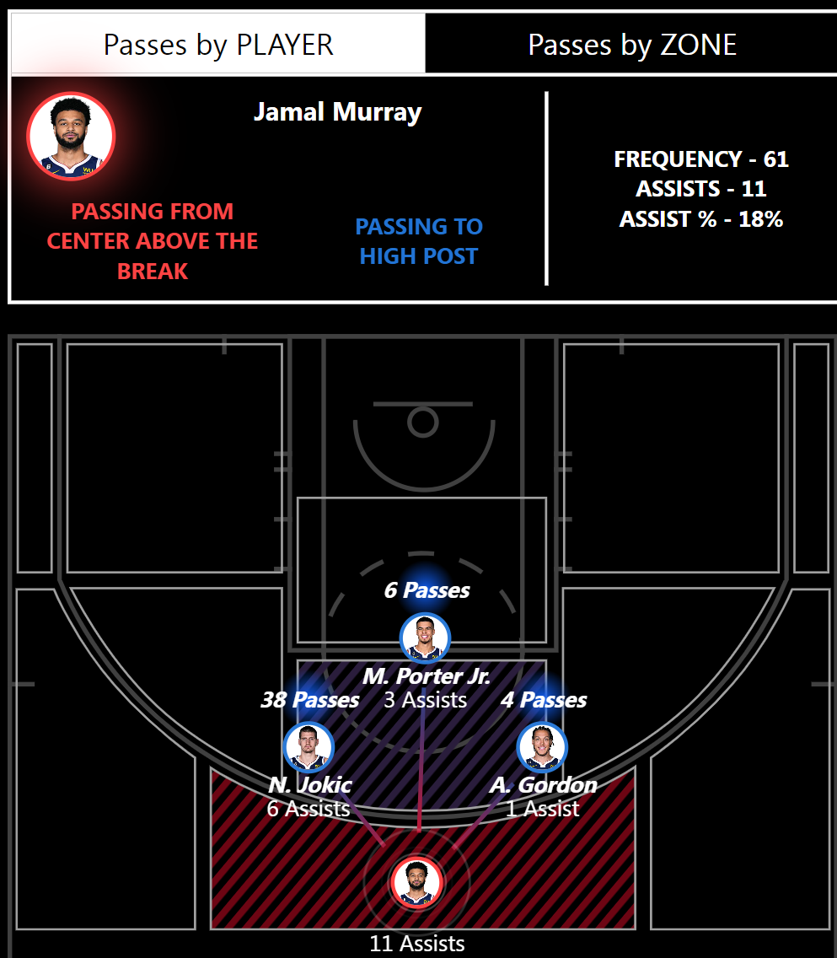
Passing Network by Player

Slide 9
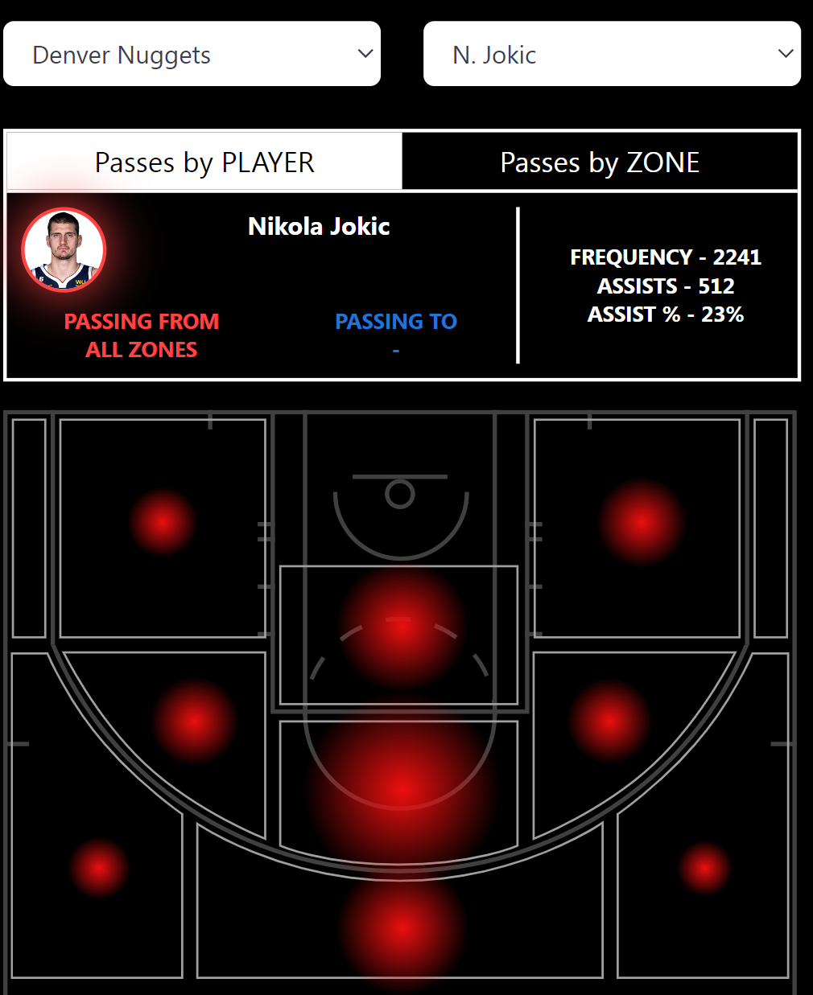
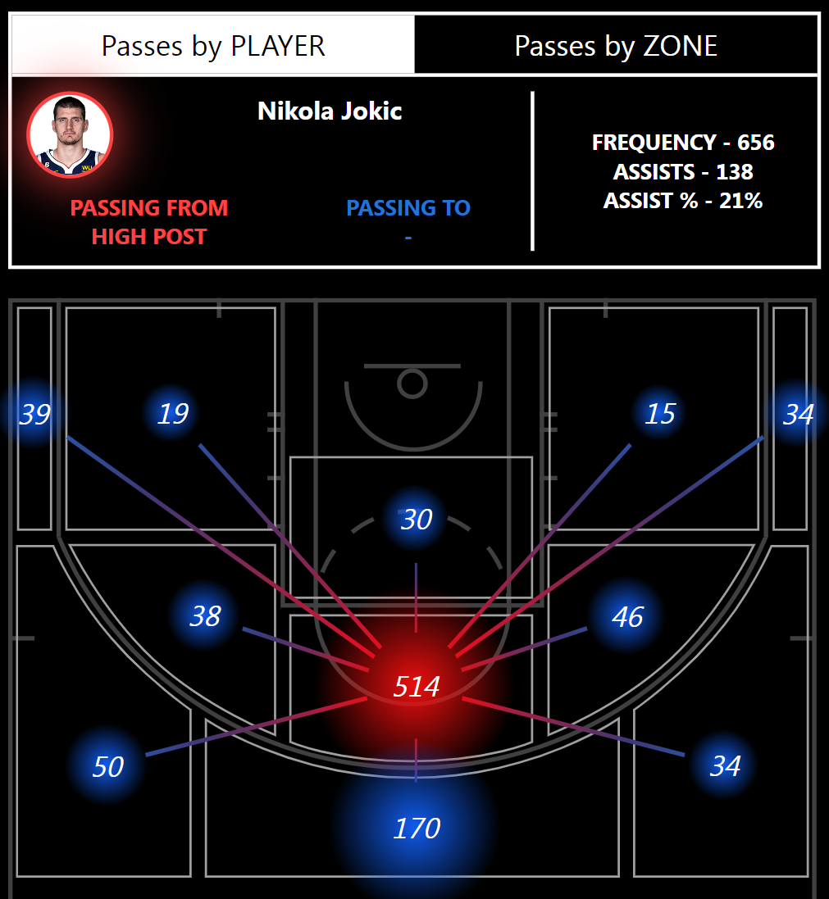
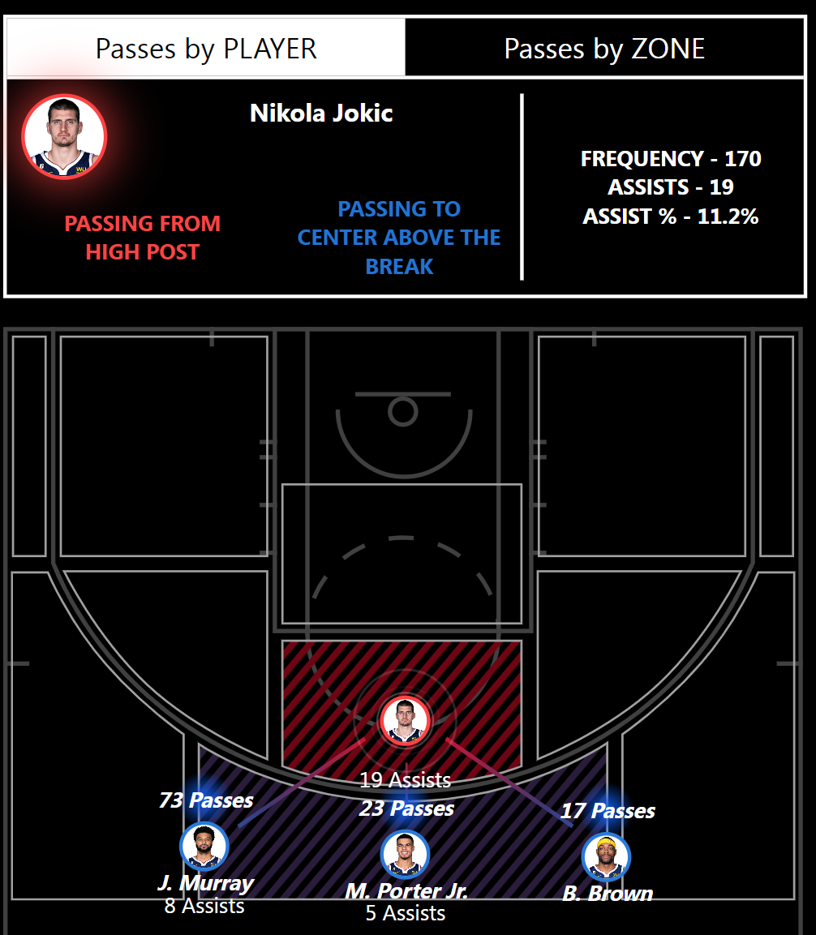

Slide 10
Passing Network by Zones (team level)
I wanted to investigate which pass spots results in the highest assist percentage, based on where the pass is passed from

Slide 11
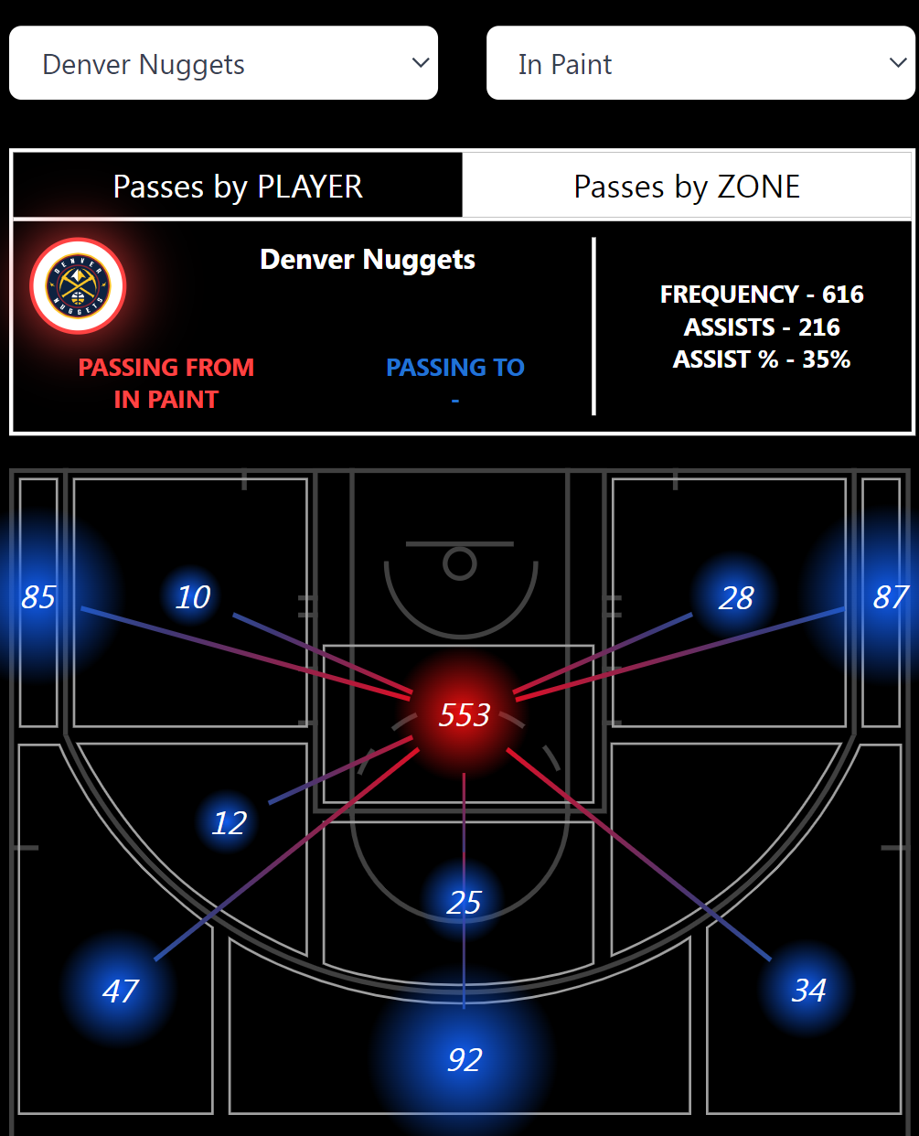
Passing in the Paint

Slide 12
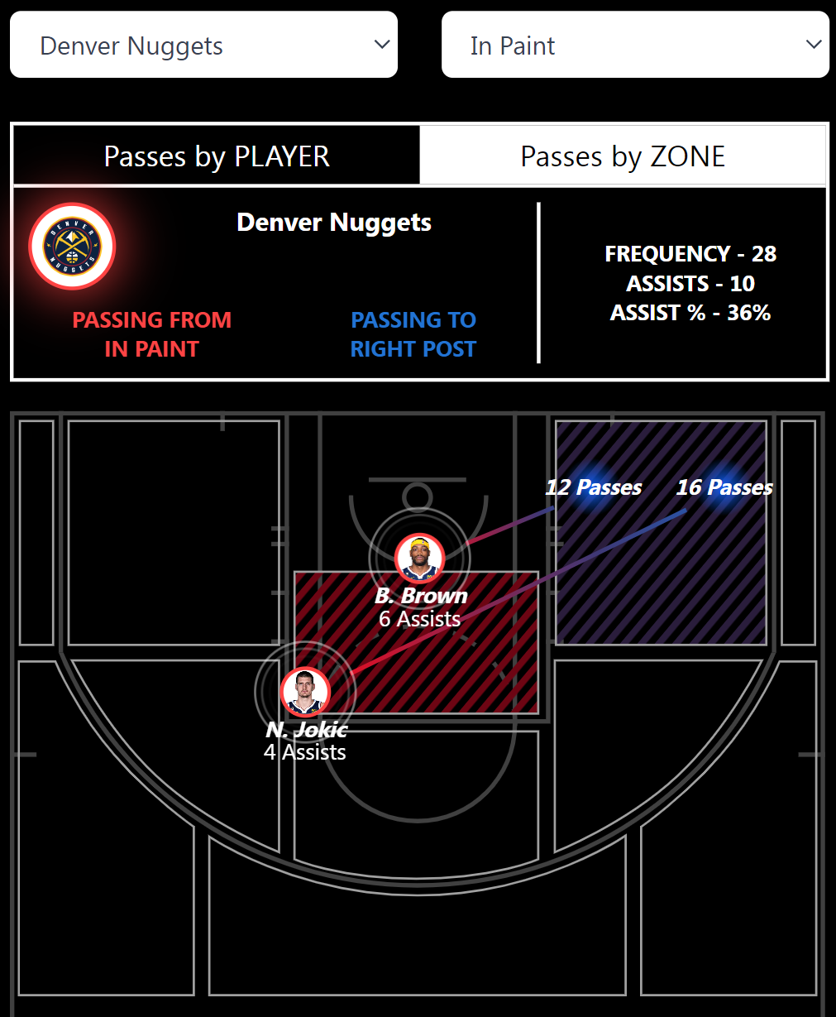
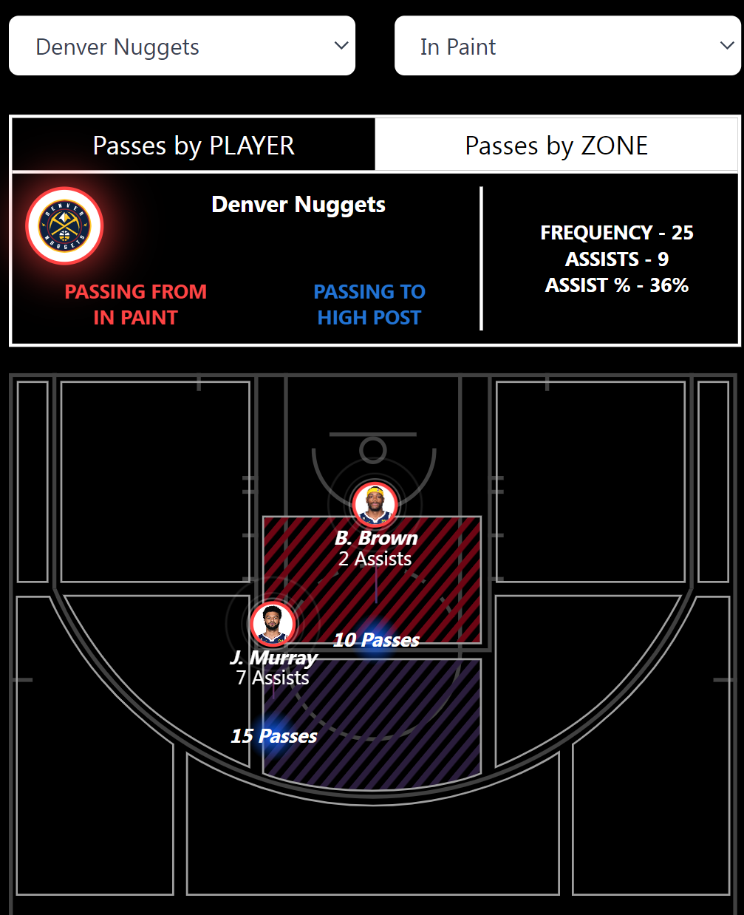
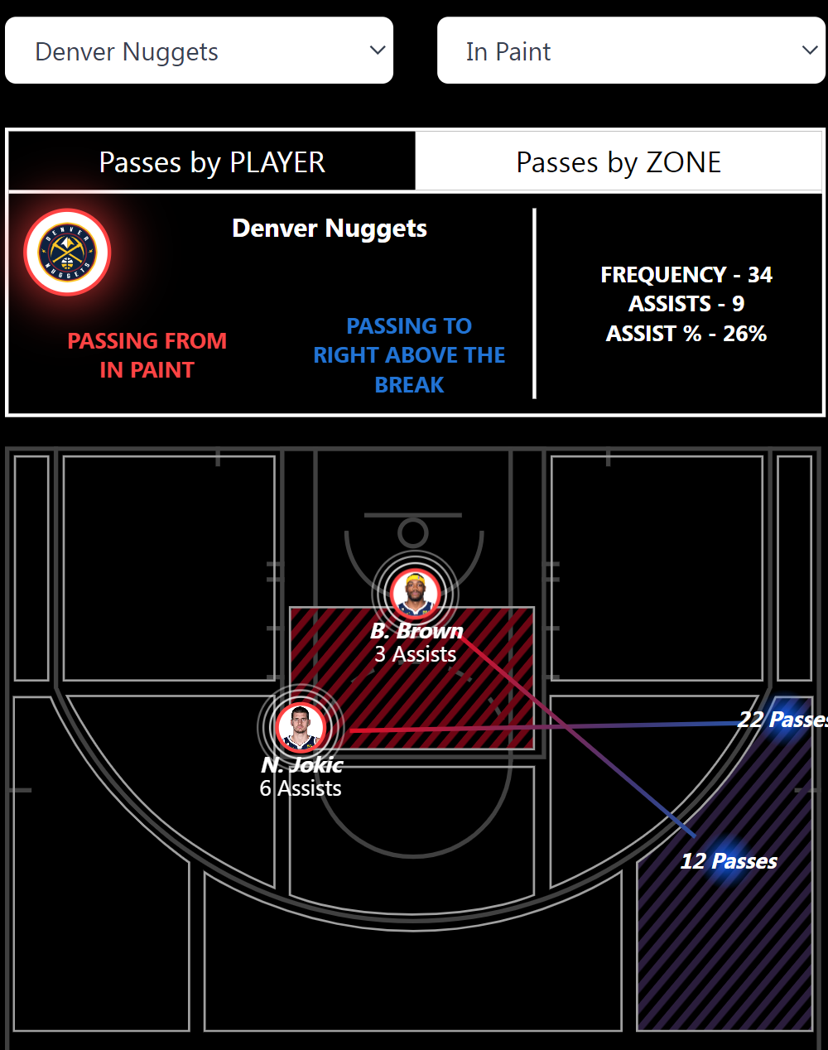

Slide 13
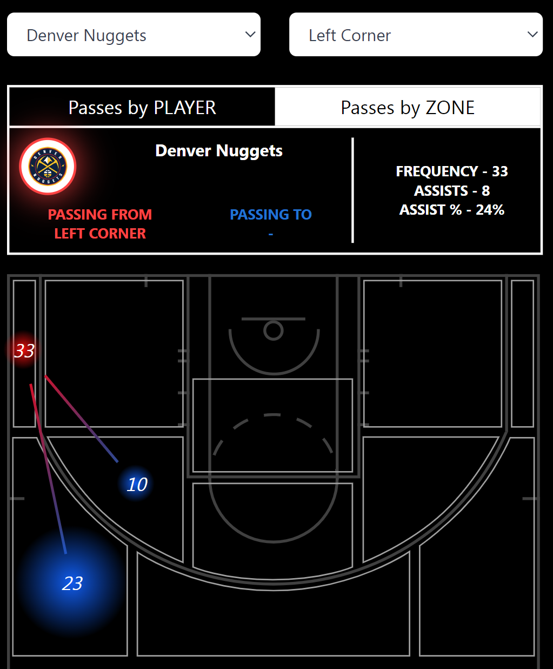
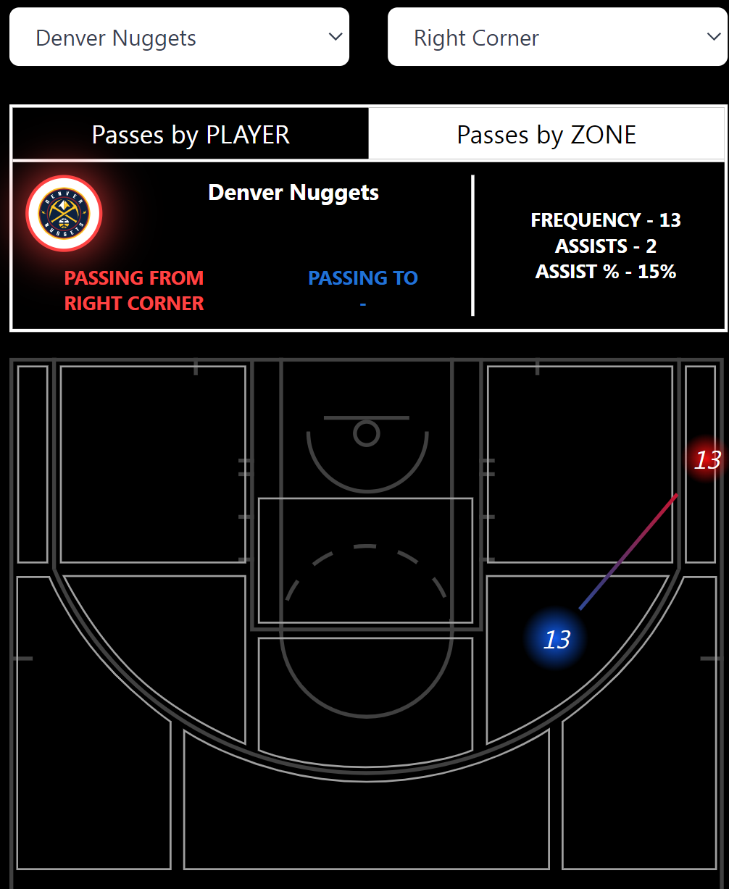
Passes from the Corner

Slide 14
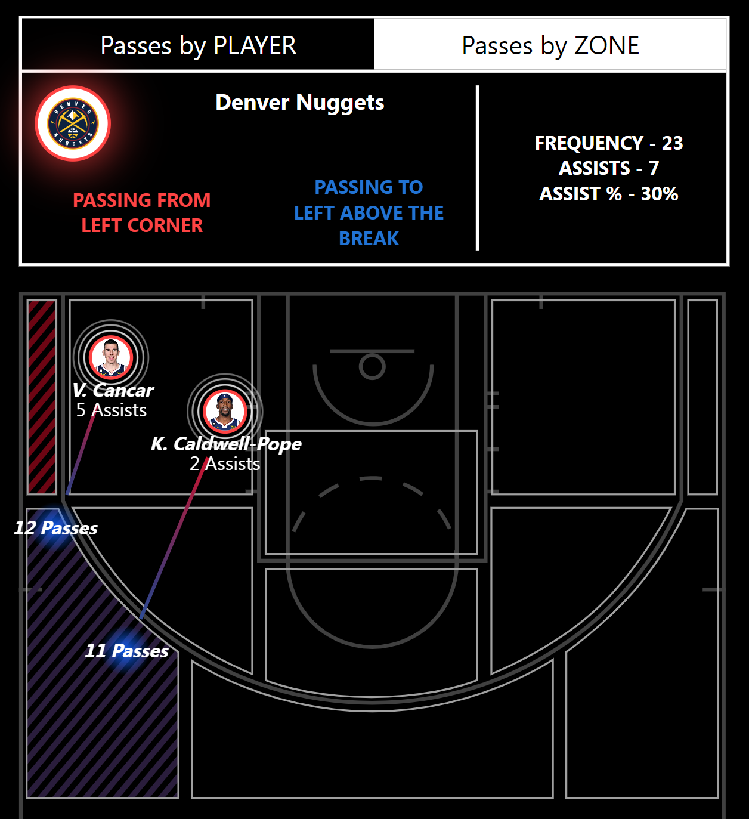
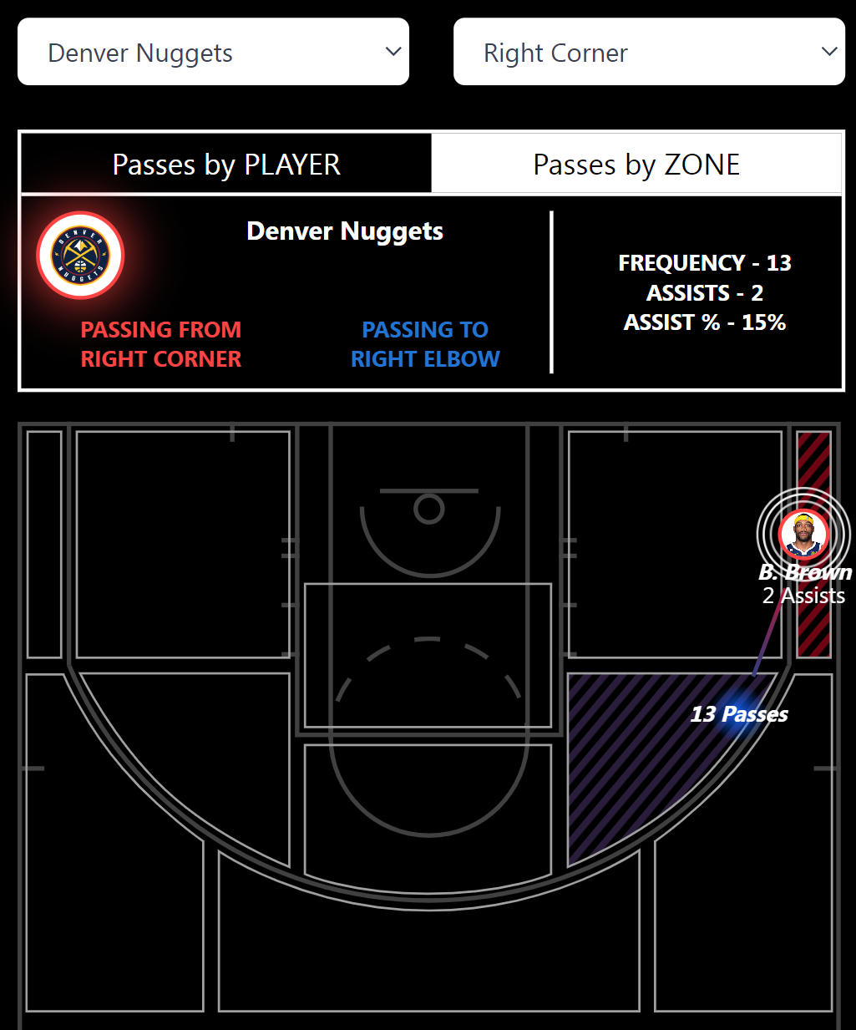

Slide 15
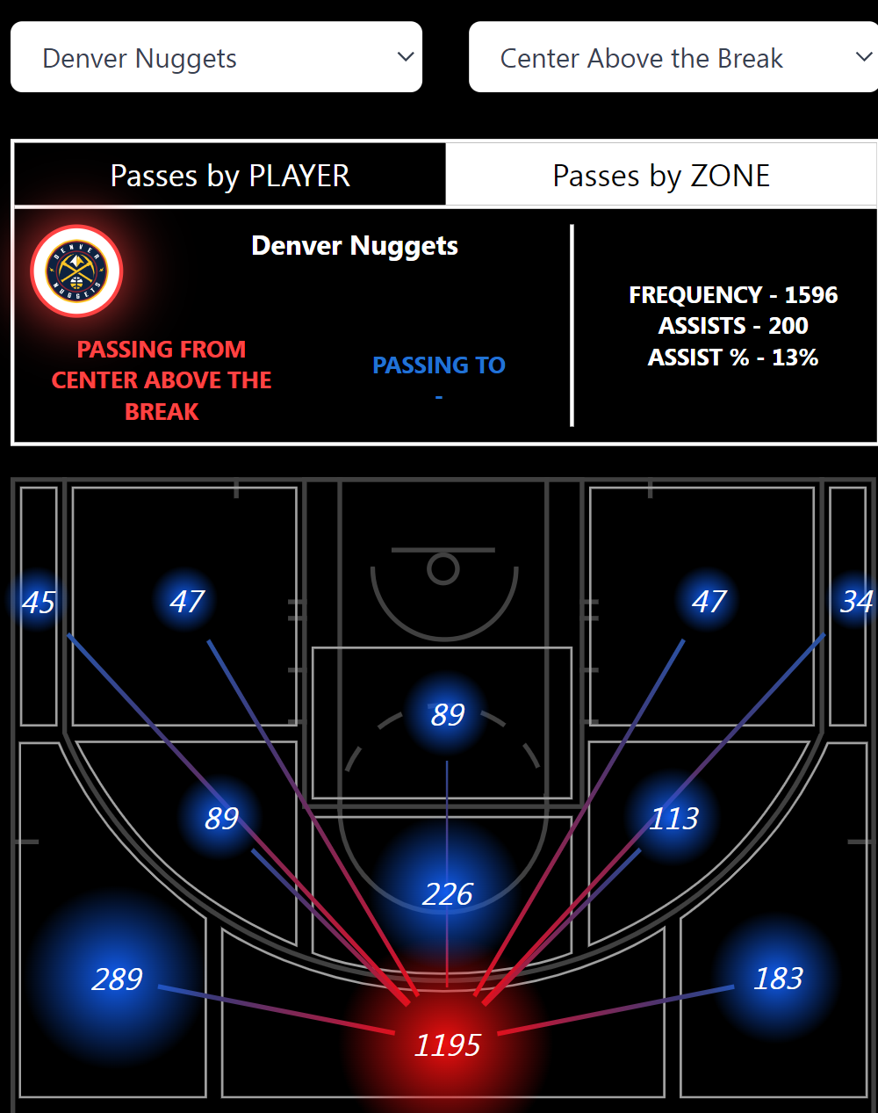
Top of the Three-Point

Slide 16
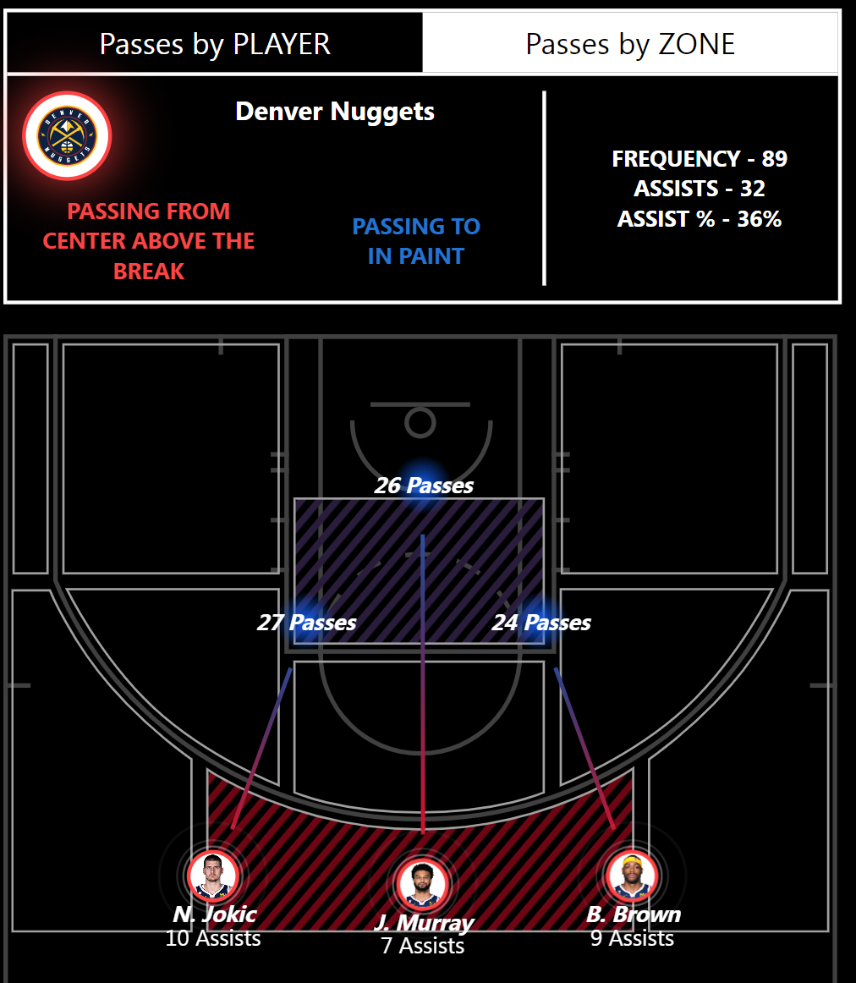
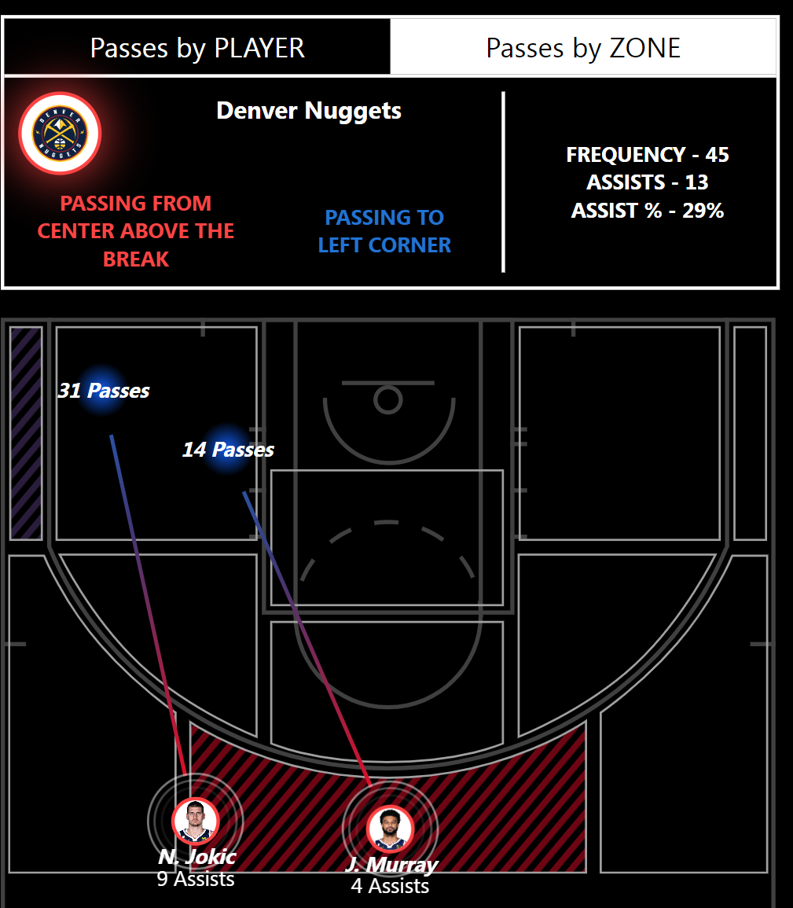

Slide 17
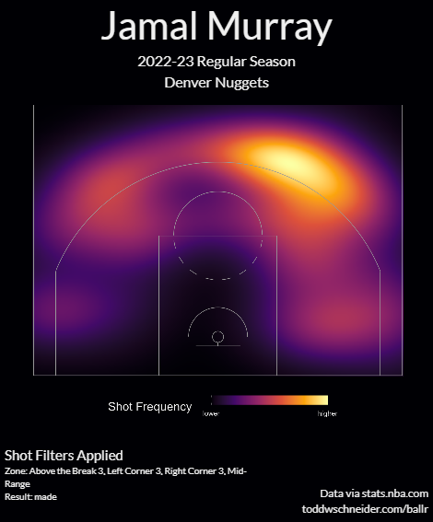
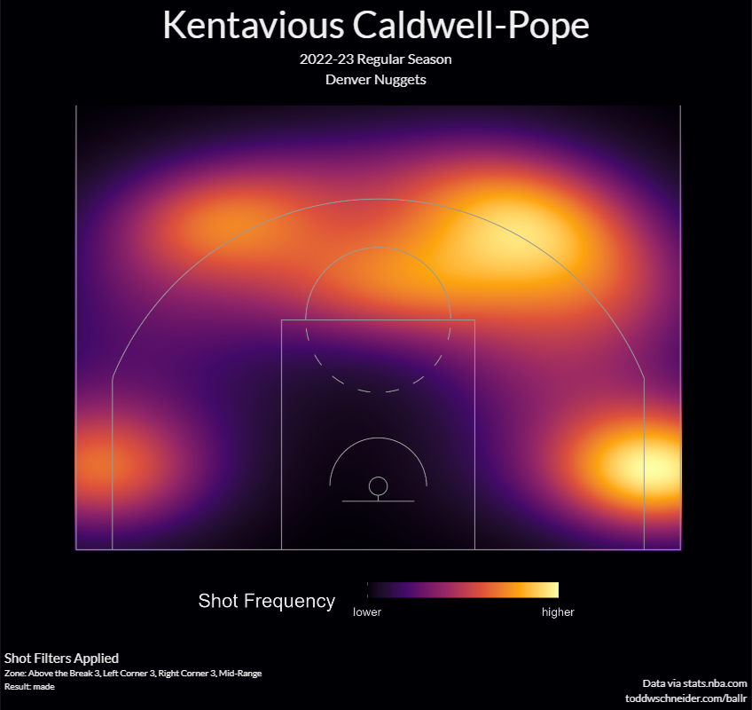
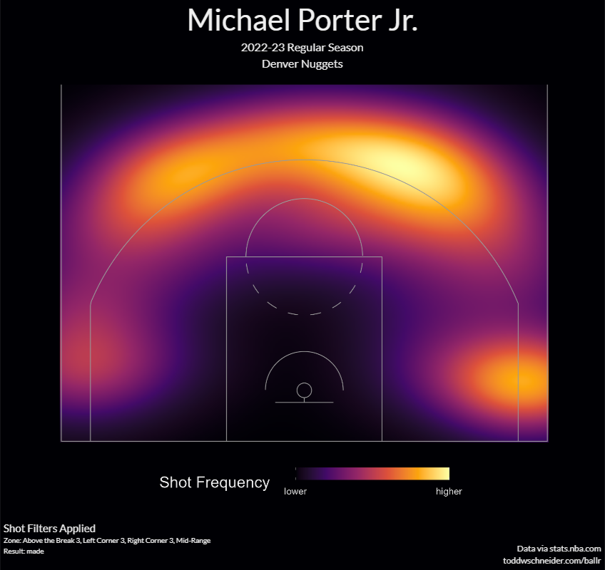
Shooting Spots for Players(regular season)

Slide 18
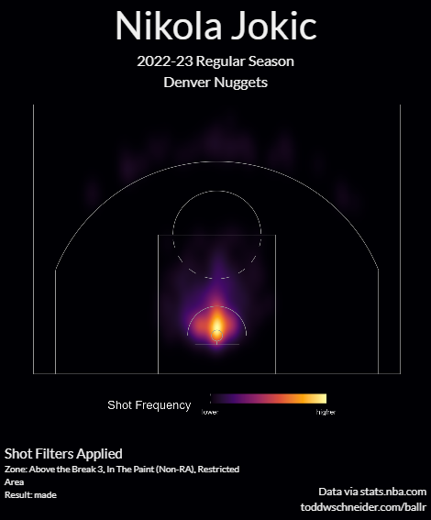
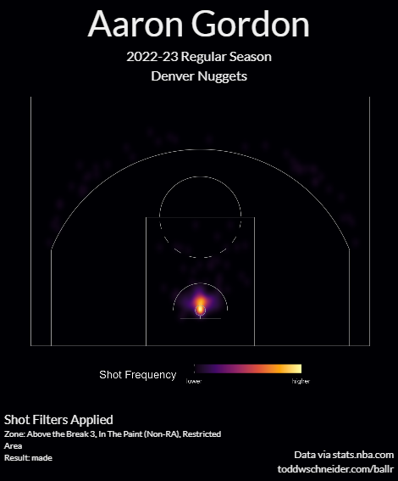
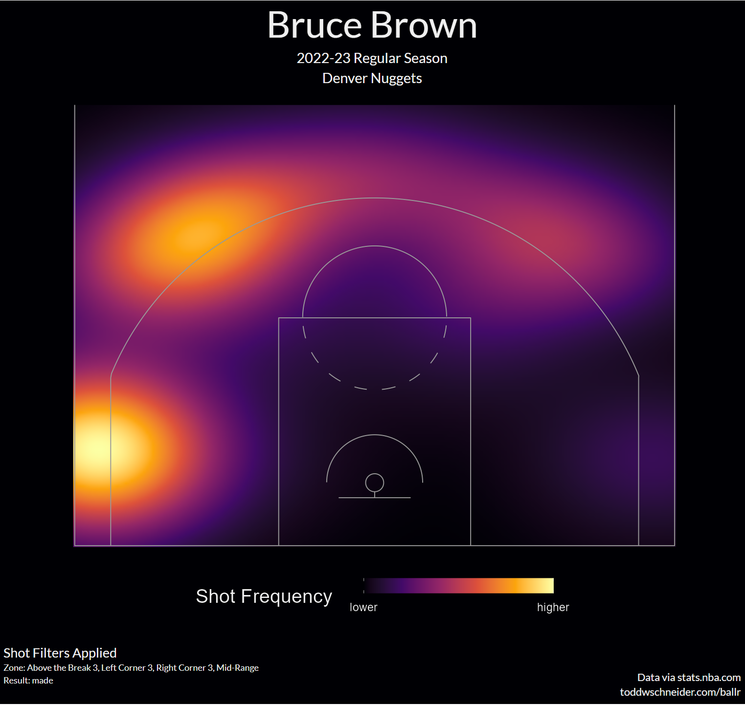
Shooting Spots for Players(regular season)

Slide 19
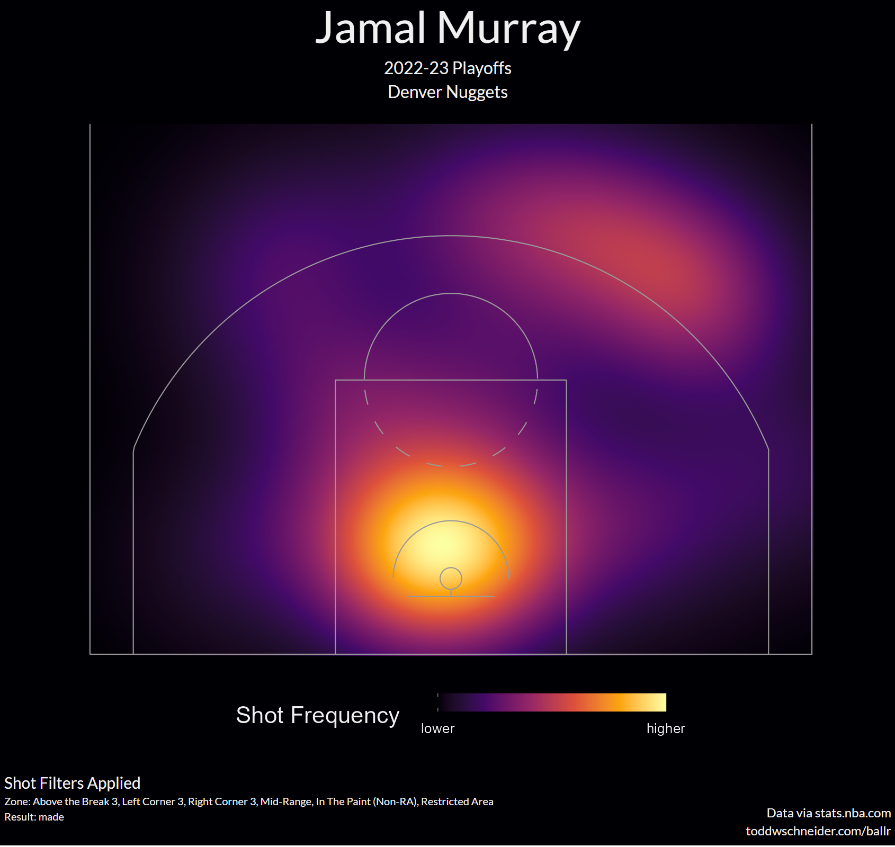
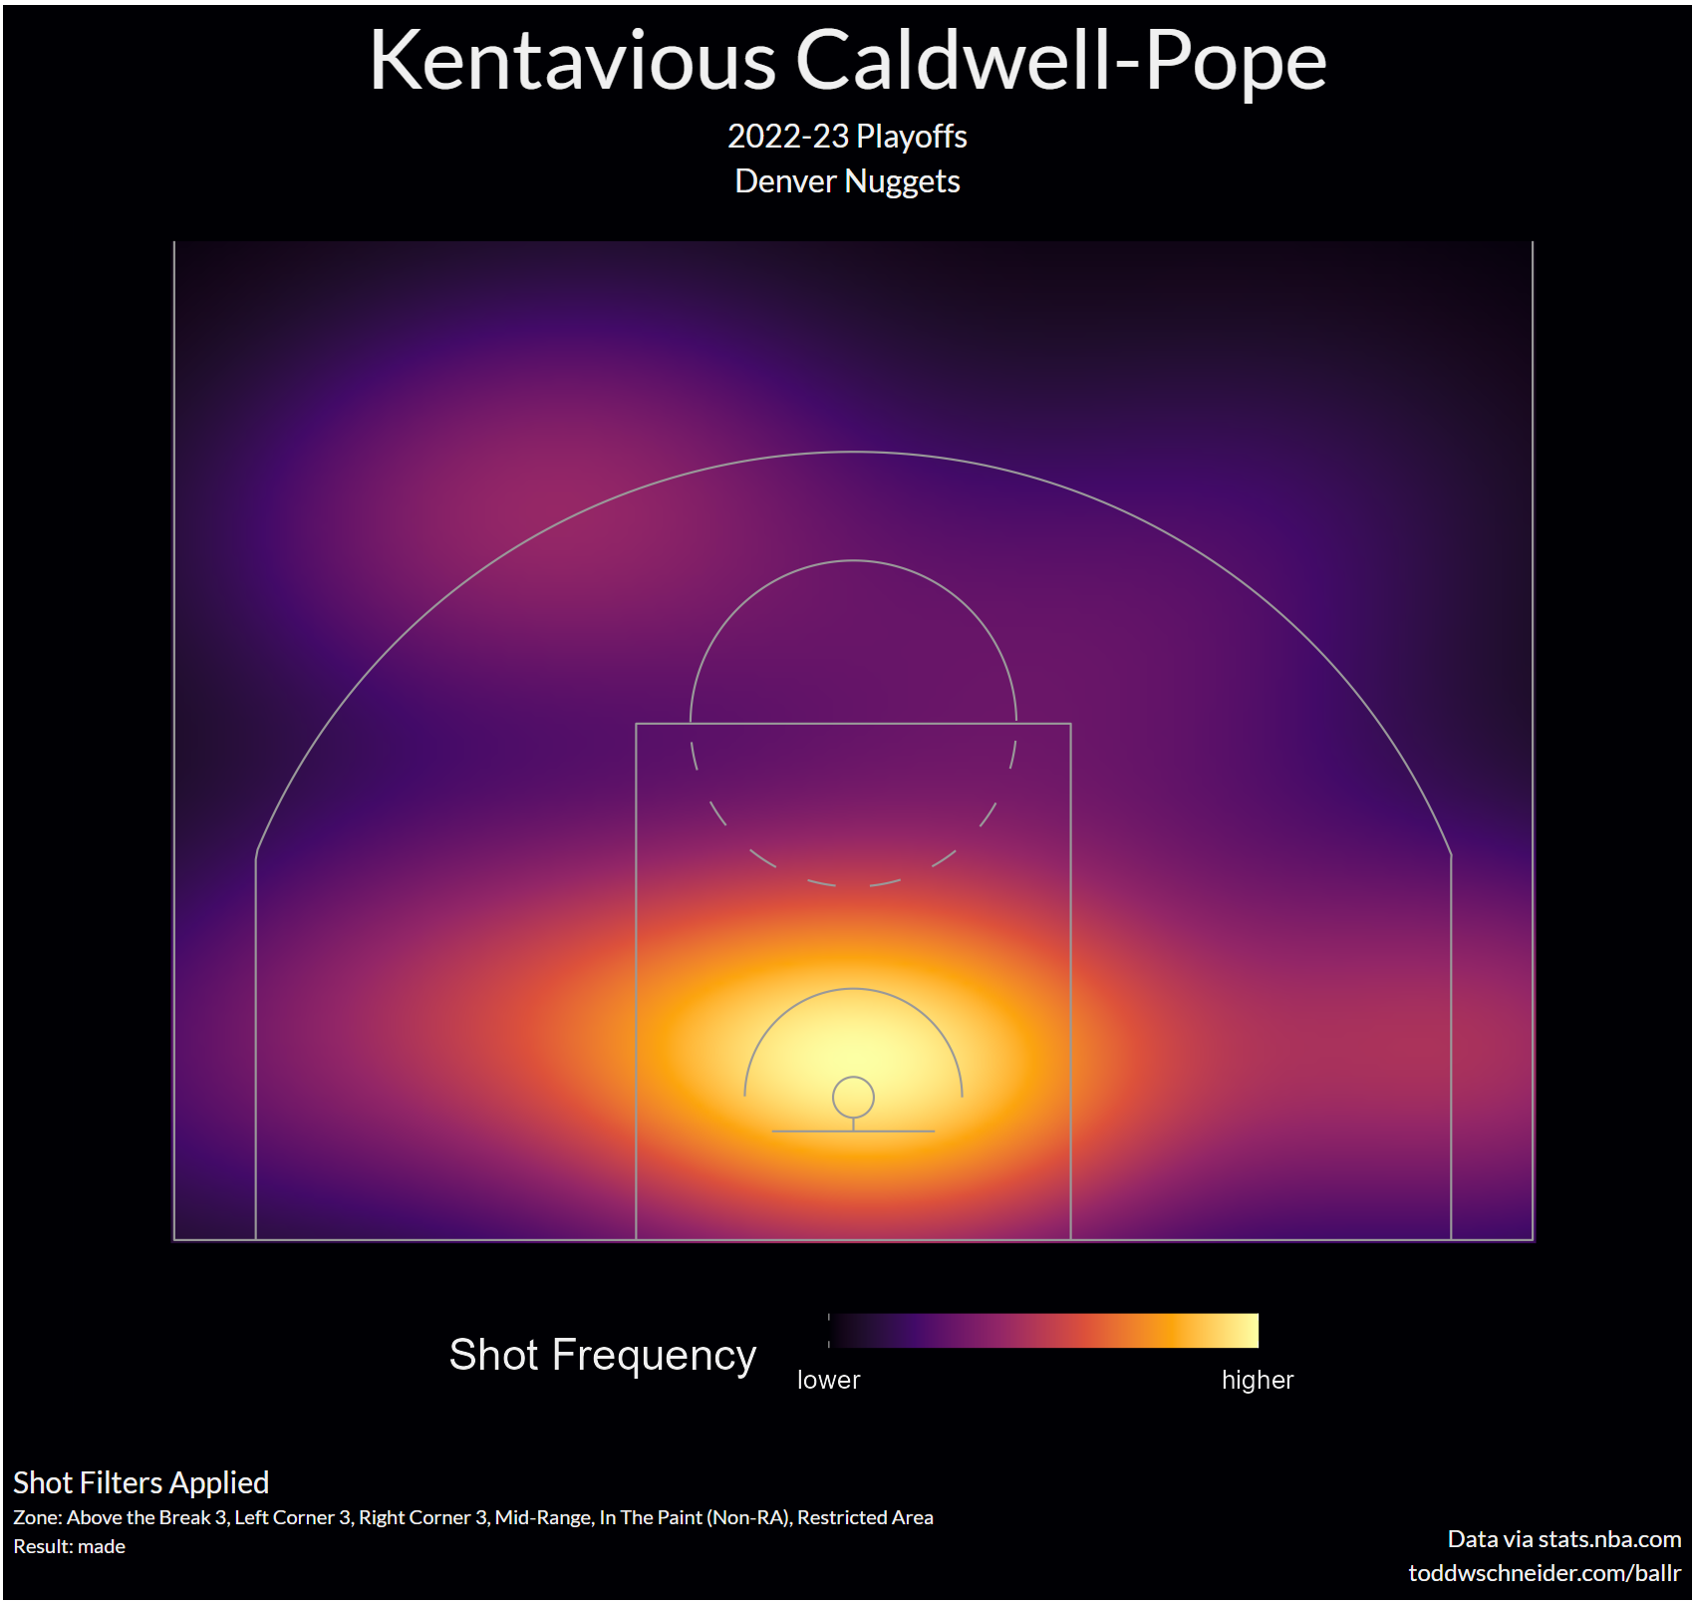
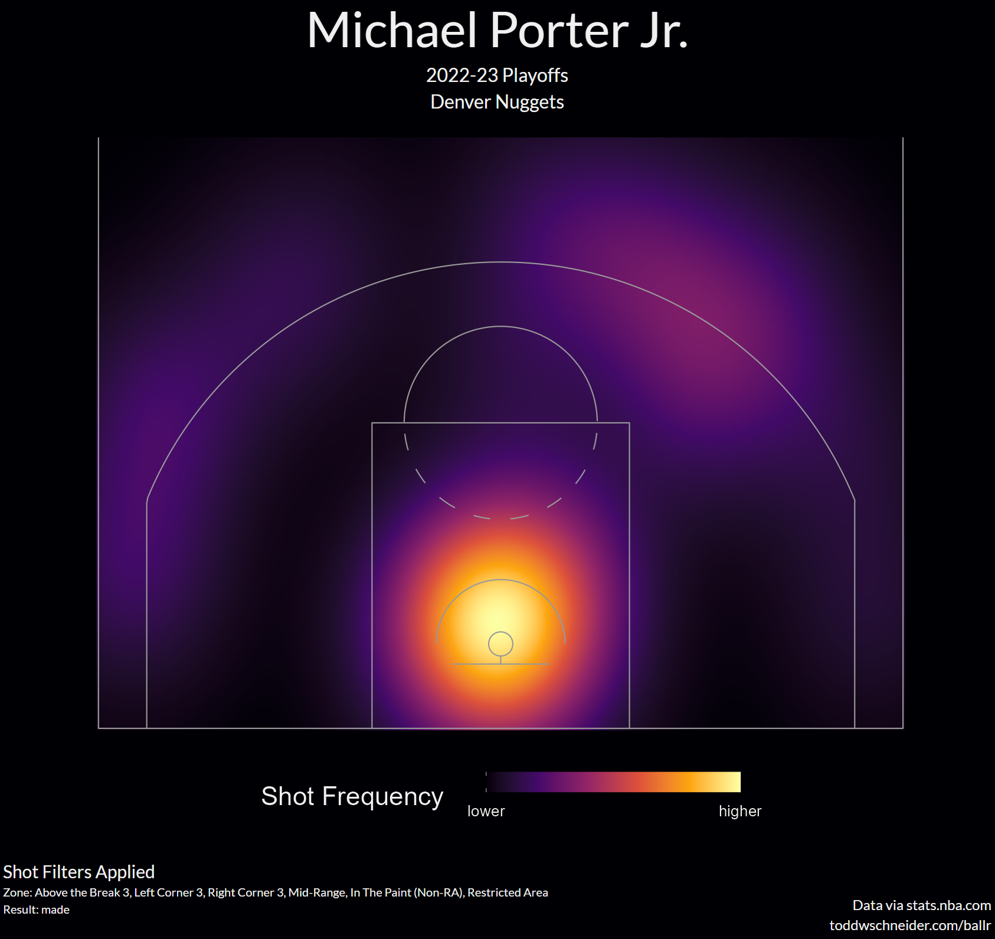
Shooting Spots for Players (playoffs)

Slide 20
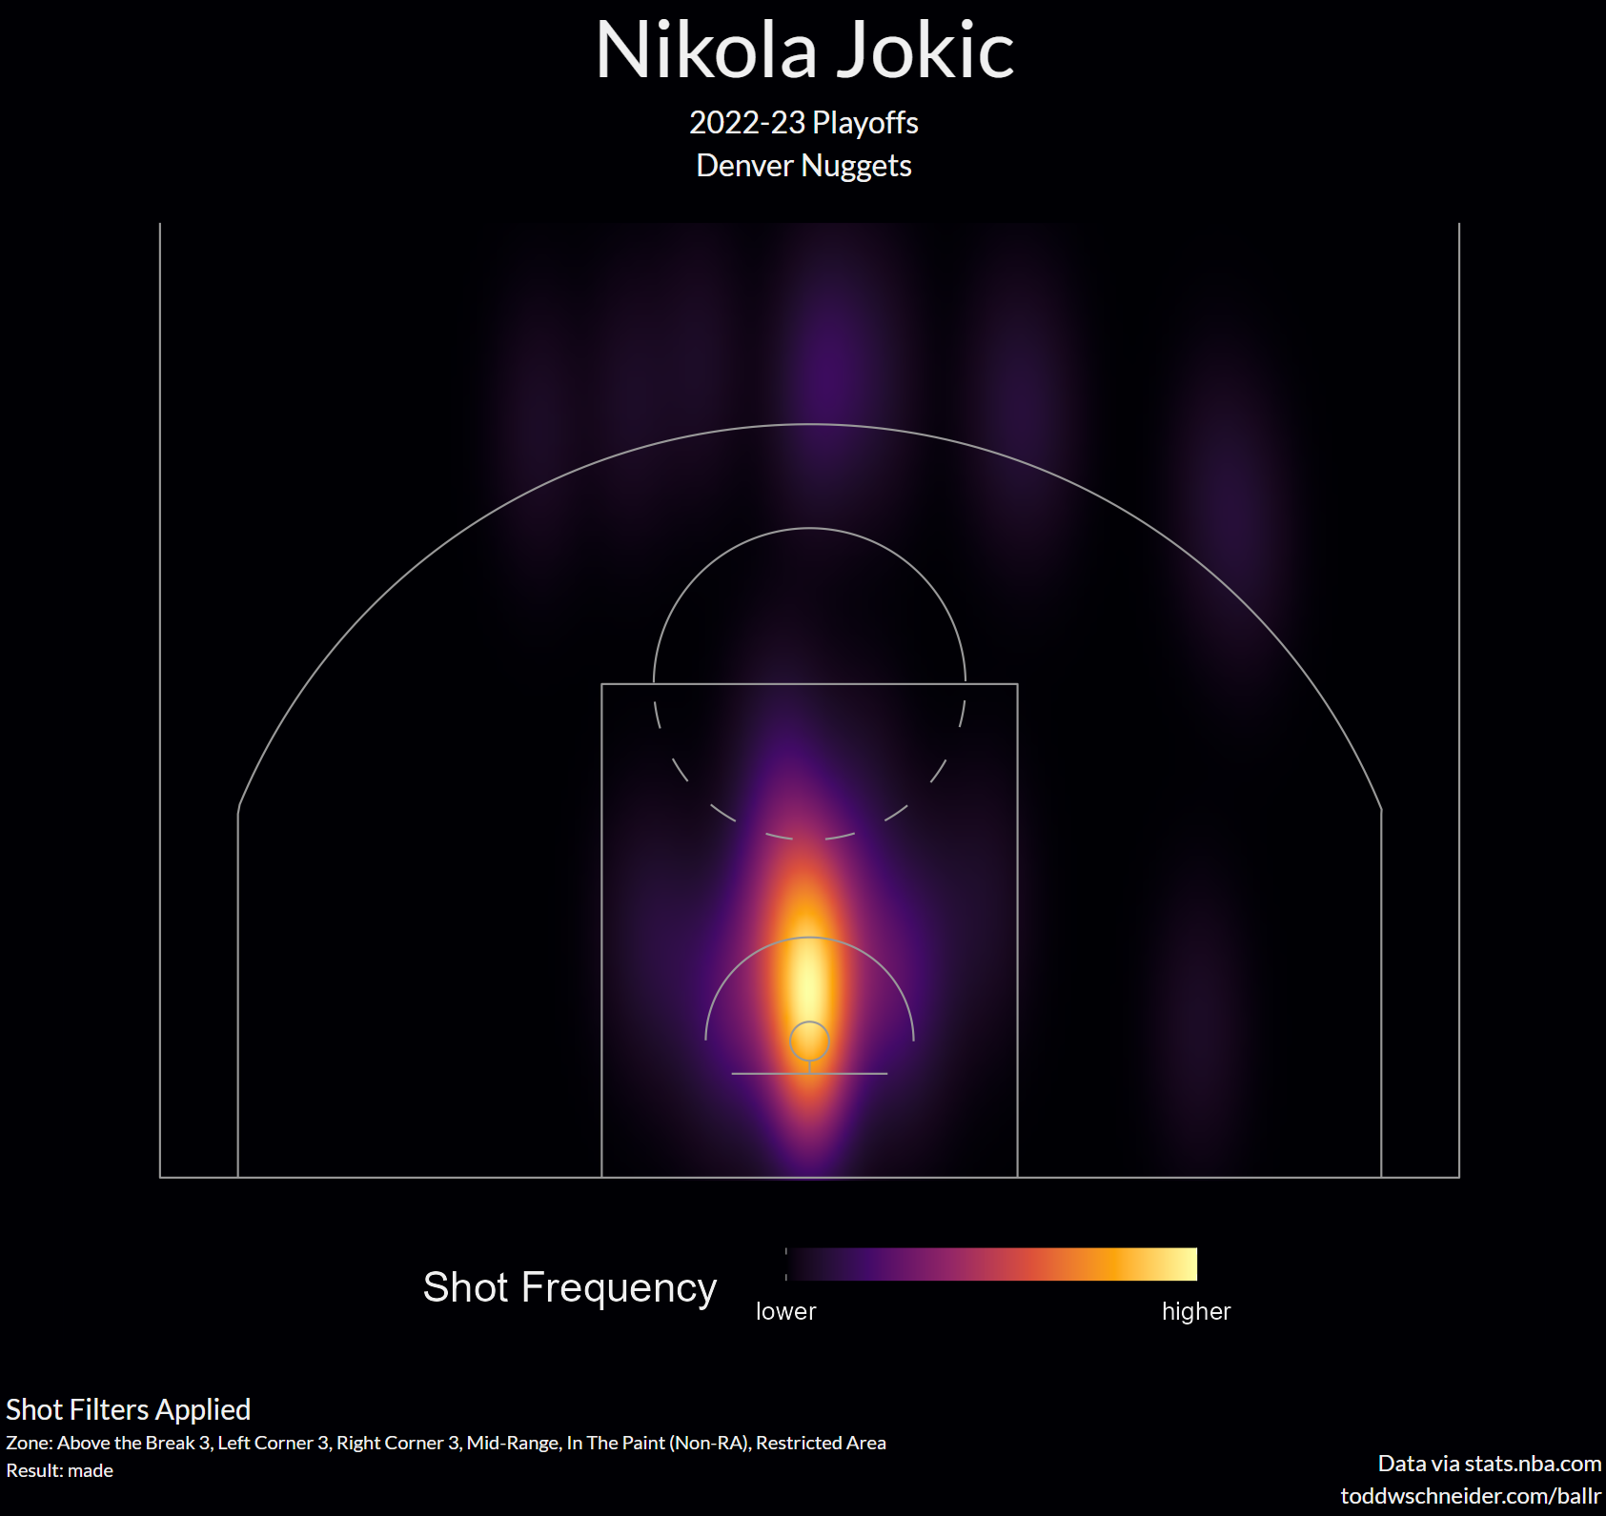
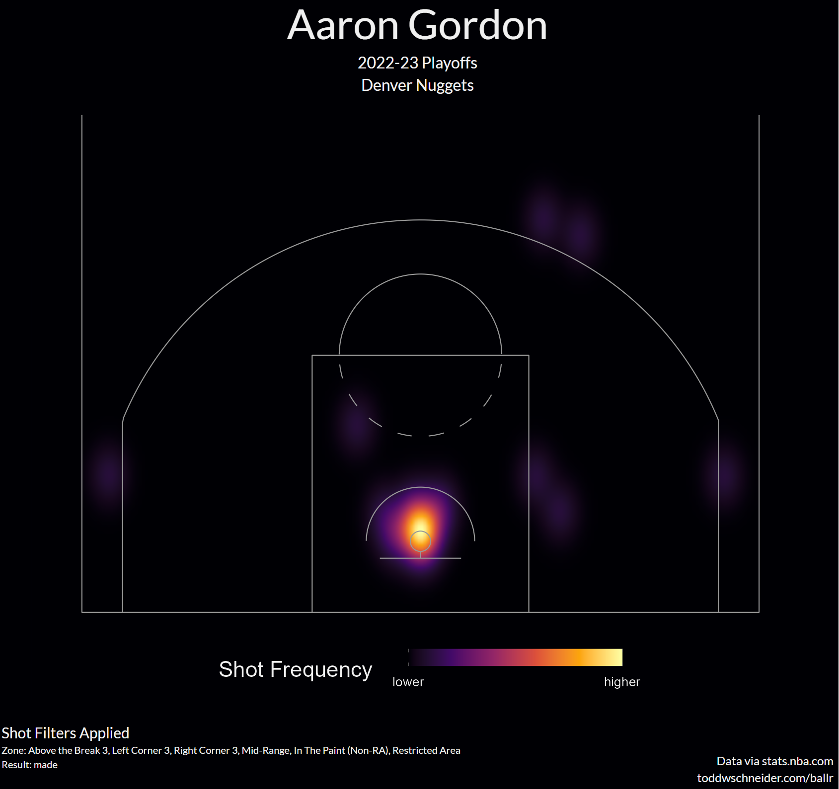
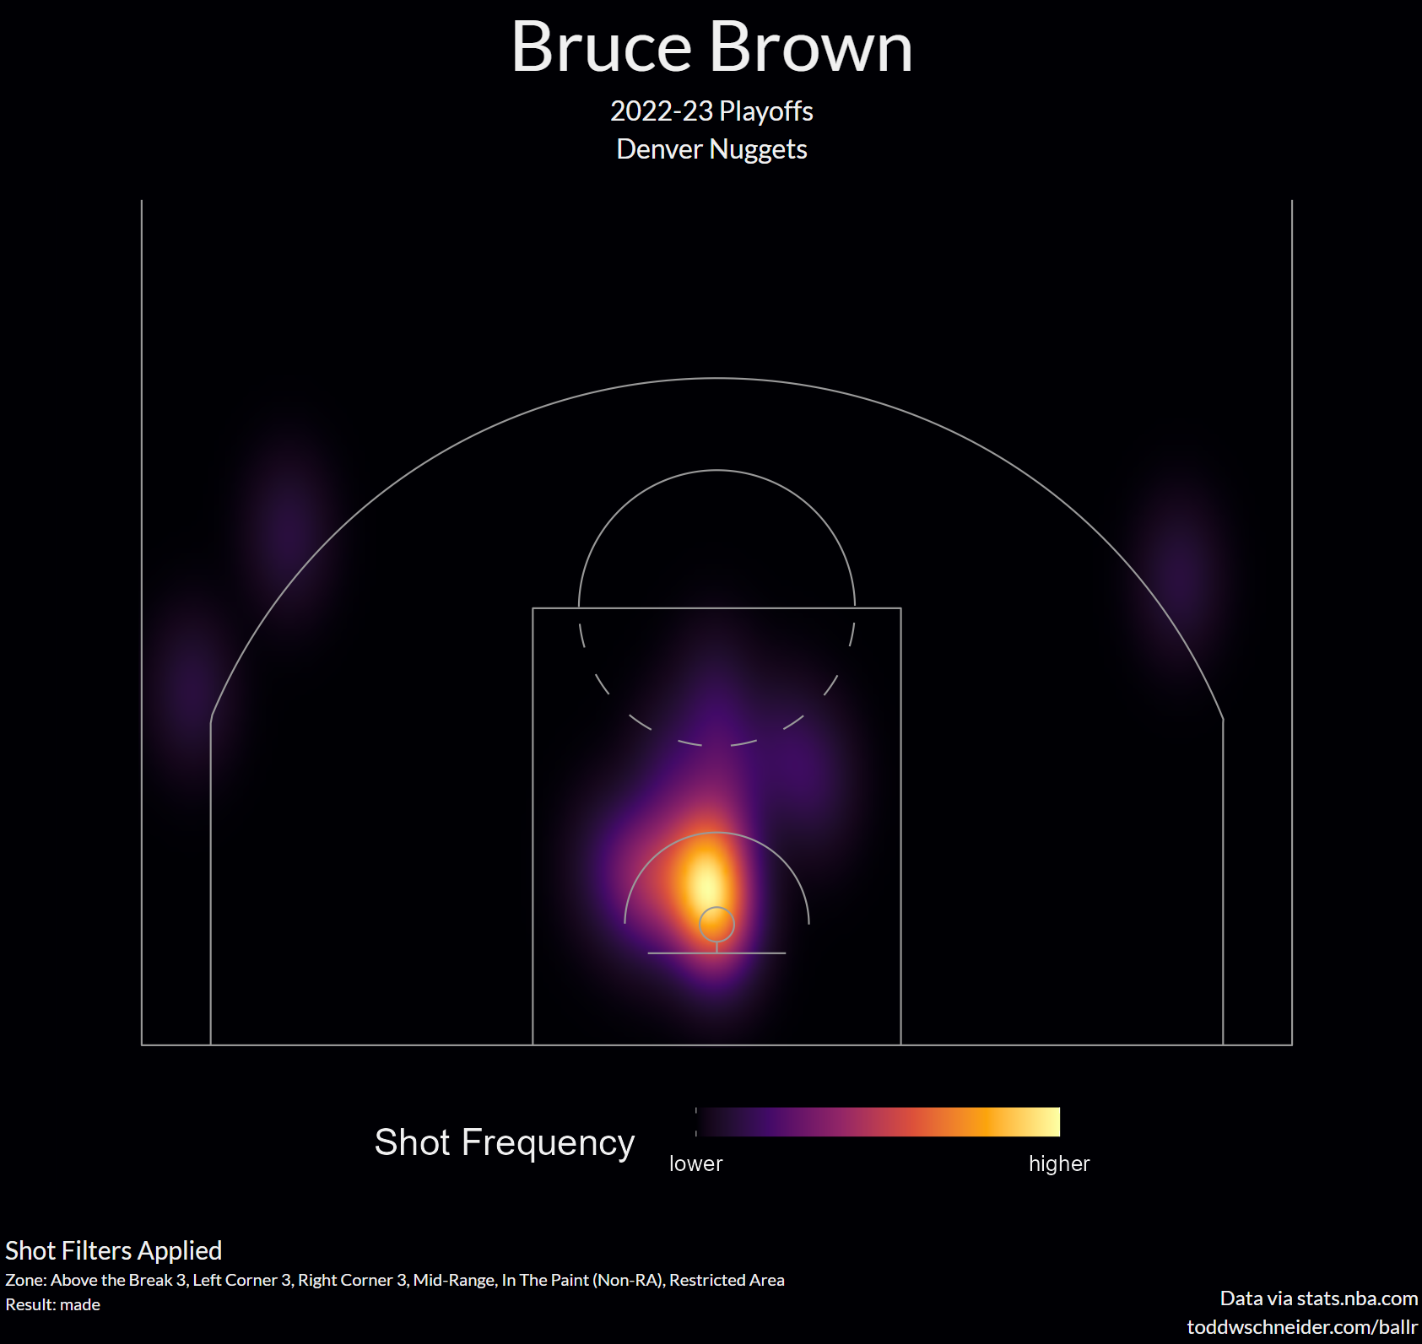
Shooting Spots for Players (playoffs)

Slide 21
Advanced Stats for Players this Season
Look at Bar plots for
Player Efficiency Rating -sums up all a player's positive accomplishments, subtracts the negative accomplishments, and returns a per-minute rating of a player's performance
Value Over Replacement - estimate of the points per 100 team possessions that a player contributed above a replacement-level (-2.0) player
True Shooting
Offensive Rating
Defensive Rating
Data from Basketball Reference

Slide 22
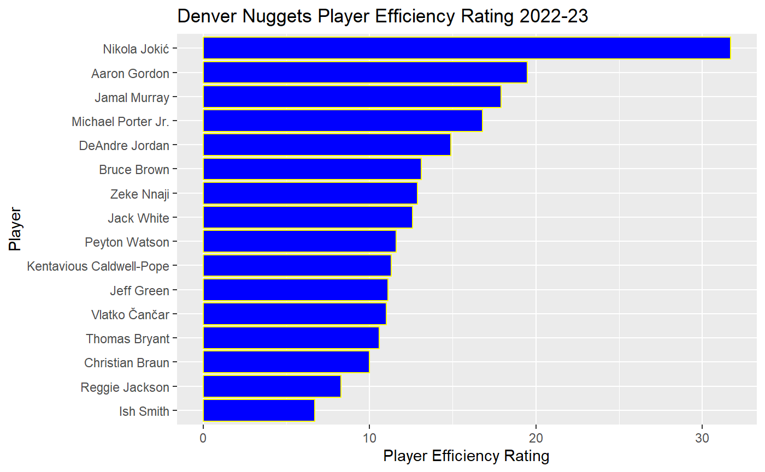
PER

Slide 23
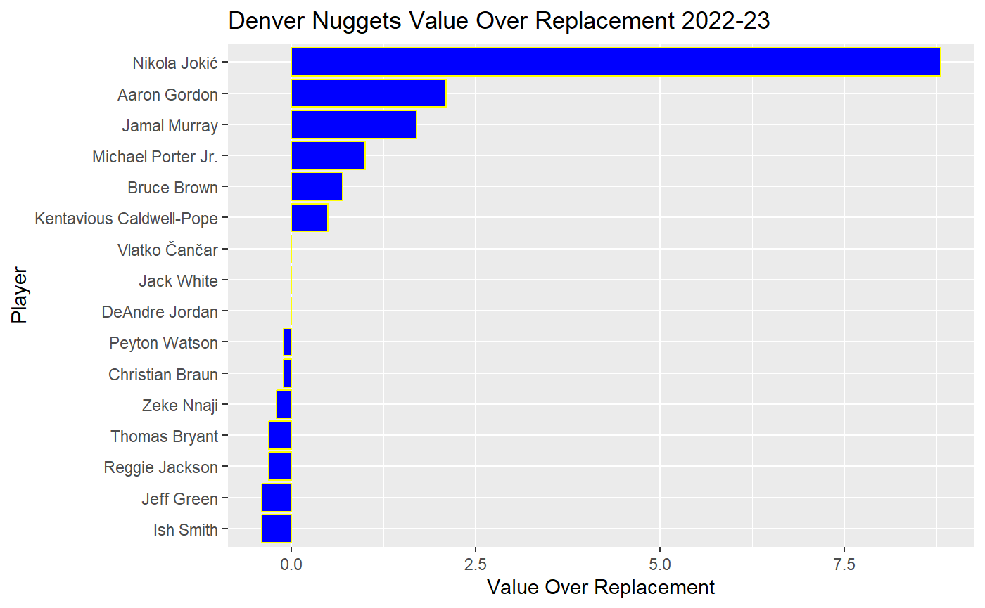
Value Over Replacement

Slide 24
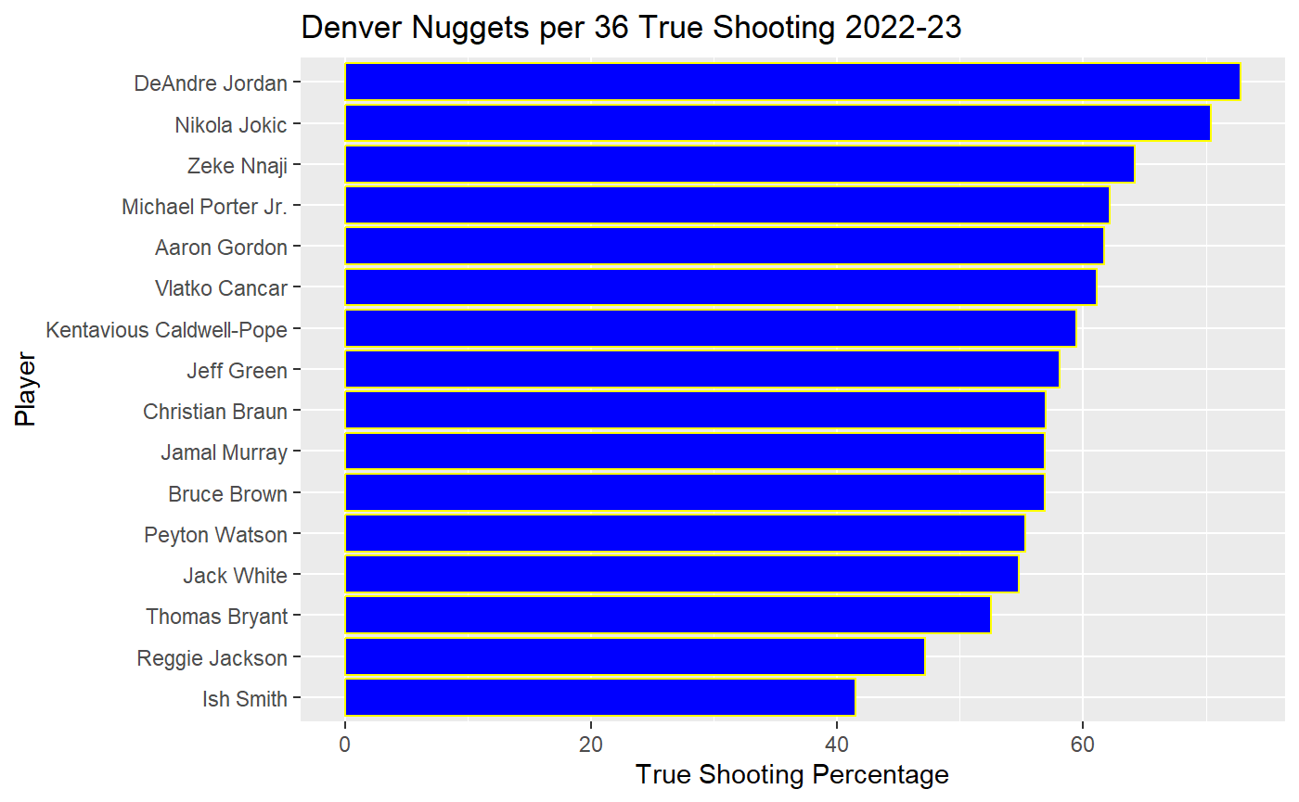
True Shooting

Slide 25
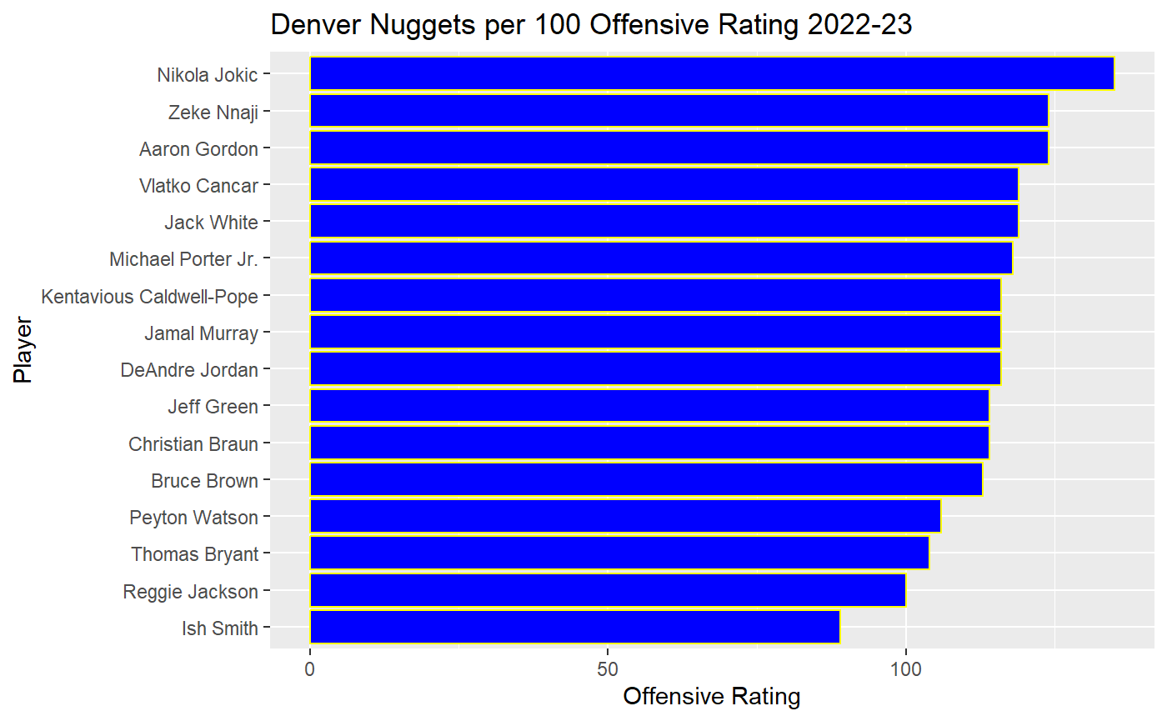
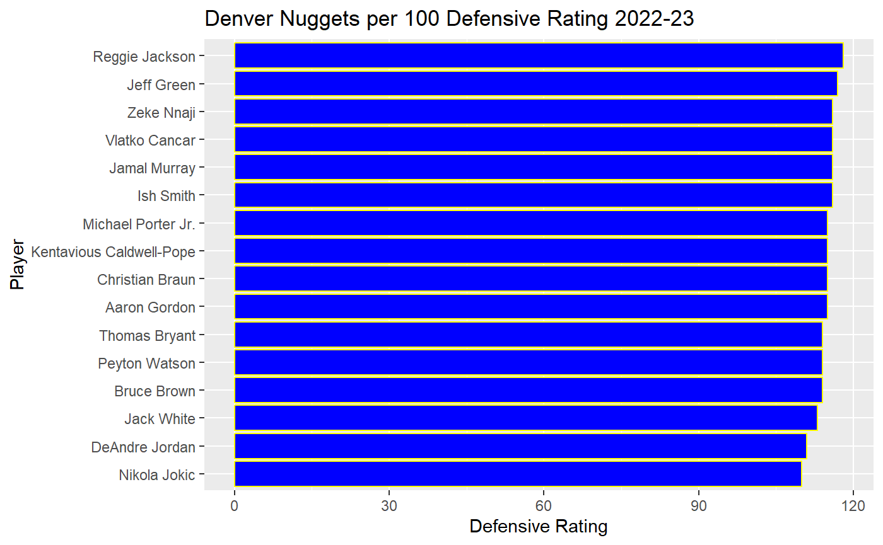
Offensive and Defensive Ratings

Slide 26
Cohens D for Players
Cohens D can be thought of as the difference in means relative to the standard deviation of the data
Will be comparing wins vs. losses for each player of
True Shooting Percentage
Turnover Percentage (four factor(offense))
Plus minus
Free throw factor (four factor(offense))
Will separate for home and away games (each player will have 8 Cohens D values)
Show which Cohens D values are above 0.6

Slide 27
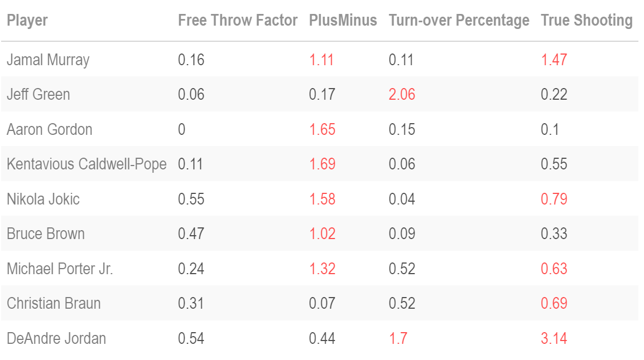
Big Effect sizes/Cohen’s D(home)

Slide 28
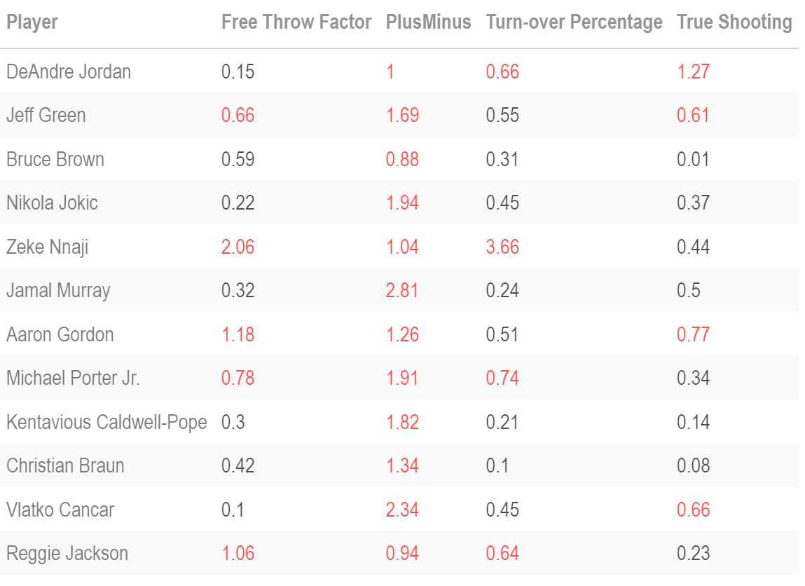
Big Effect Sizes/Cohen’s D (away)

Slide 29
Cohens D for Team
I did Four Factors and True Shooting percentage
Computed Cohens D for home games (wins vs. loss) and for away games(wins vs. loss) on a team level.

Slide 30
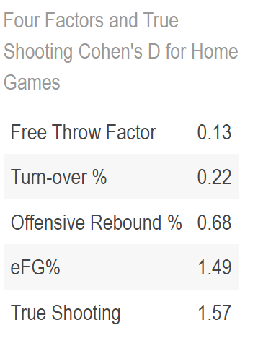
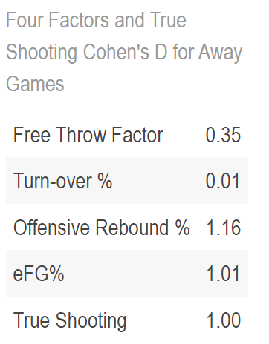
Cohens D Values

Slide 31
Future Research
Could use some of my results to optimize plays, do odds/odds ratio of certain scenarios, etc.
Data on different combinations of players on the court at a time.

Slide 32
References
Google Search, Google, https://www.google.com/search?q=aaron%2Bgordon%2Bdunk%2Bagainst%2Bgrizzlies&rlz=1C1CHBF_enUS911US911&sxsrf=APwXEdcjPxMq59DiKkWGfE-qerKlmUidmQ%3A1682971301831&source=lnms&tbm=isch&sa=X&ved=2ahUKEwjqkfPU9NT-AhXgFzQIHV49BxwQ0pQJegQIAhAE&biw=1500&bih=881&dpr=2.
“Glossary.” Basketball, https://www.basketball-reference.com/about/glossary.html#:~:text=VORP%20%2D%20Value%20Over%20Replacement%20Player,to%20an%2082%2Dgame%20season.
“NBA Courtoptix.” NBA.com, https://nbacourtoptix.nba.com/en.
Toddwschneider. “Toddwschneider/Ballr: Interactive NBA and NCAA Shot Charts with R and Shiny.” GitHub, https://github.com/toddwschneider/ballr.
“2022-23 Denver Nuggets Roster and Stats.” Basketball, https://www.basketball-reference.com/teams/DEN/2023.html.

